Slide 1
MR Final - Evals
Direct Sparse Odometry (DSO) +
Semi - Global Block Matching (SGBM)
TEAM 11
Aniruth Suresh
Aryan Garg
Pratyush Jena

Slide 2
Why DSO ? Motivation ?
Issue with traditional Odometry methods :
- face difficulties in large-scale environments, dynamic scenes, and low-texture areas
- feature matching techniques, such as SIFT, SURF, or ORB, to extract keypoints → Impacts runtime
How does DSO overcome this ? DIRECT + SPARSE !!
Uses sparse set of keypoints → No feature matching techniques (just uses simple intensity gradients)
Sparse formulation avoids the use of a smoothness prior
Also accounts for non - linearity in the camera sensor !

Slide 3
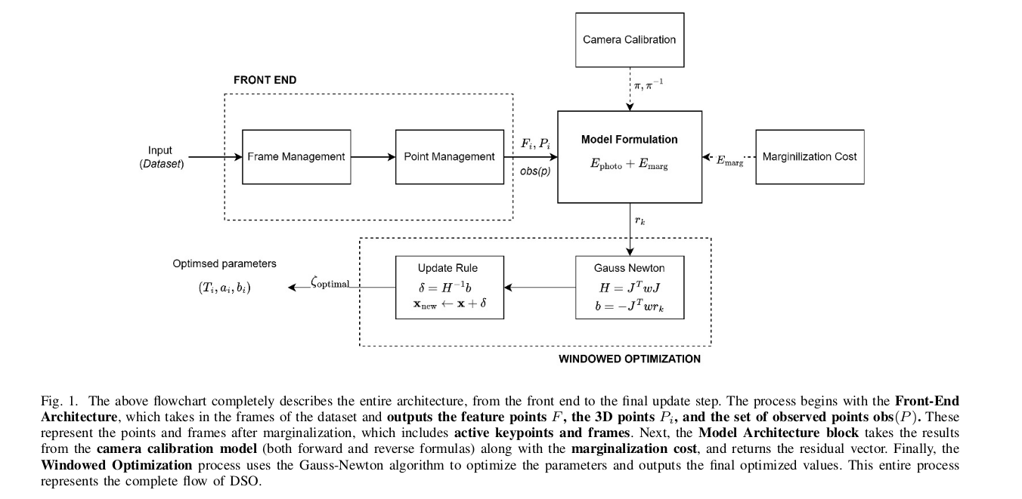
COMPLETE PIPELINE

Slide 4
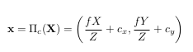
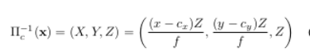
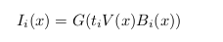
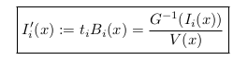
A . Calibration
Uses both :
Geometric Camera Model :
DSO employs the well-known pinhole camera model.
(b) Photometric Camera Model :
DSO uses an image formation model that accounts for non-linear response and lens attenuation
G = non linear response function , ti = exposure time , V = lens attenuation (vignette) ,
I’ = corrected image , B = irradiance

Slide 5
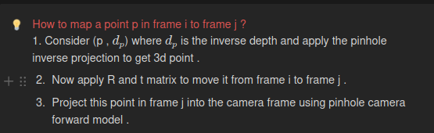
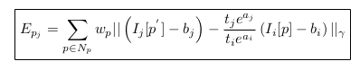
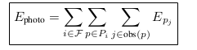
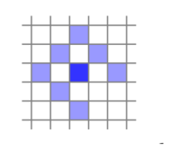
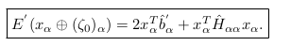
B . Model Formation
Uses two cost : Photometric Cost + Marginalization Cost
Photometric Cost :
- Np is the set of pixels included in the SSD
- ti , tj are the exposure times for images Ii and Ij
(b) Marginalization Cost :
Old variables are removed by marginalization using the Schur
Complement → detailed discussion about this in report !
Notes:
Why use inverse depth ? To make the distribution gaussian and far points will be mapped to inf

Slide 6
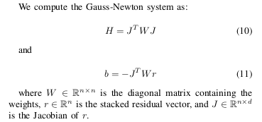
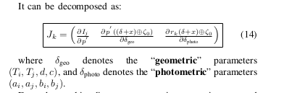
C .Windowed Optimization
The current state estimate is hence given by ζ = x ⊕ ζ0 , where x represents the incremental updates and ζ0 is the evaluation point.
Simply put ,we have ζ currently , and we are just looking for a x which gets iteratively refined until the error reaches a minimum !!
And the increment is x ← x + delta (same as ICP SLAM lie - algebra)
Notes:
Why use inverse depth ? To make the distribution gaussian and far points will be mapped to inf

Slide 7
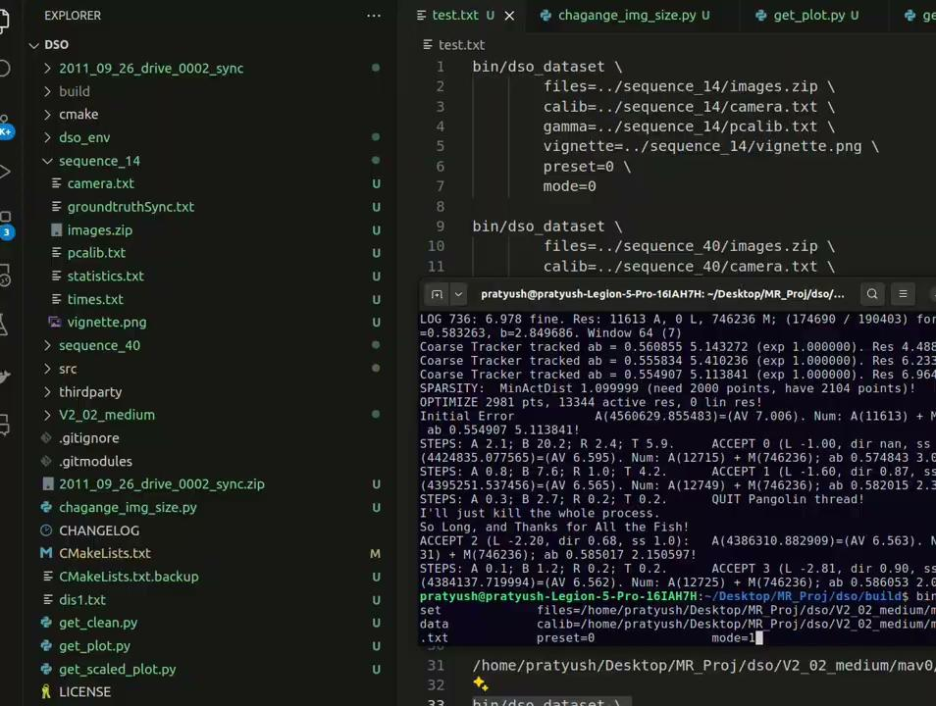
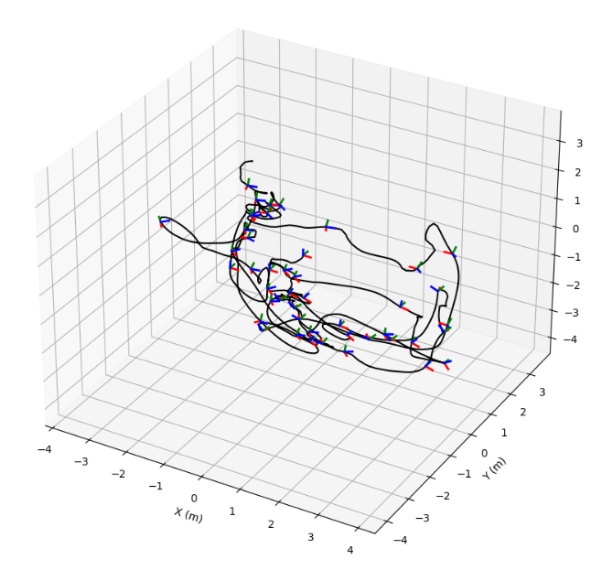
RESULTS - EUROC V2-02-medium
Notes:
Why use inverse depth ? To make the distribution gaussian and far points will be mapped to inf

Slide 8
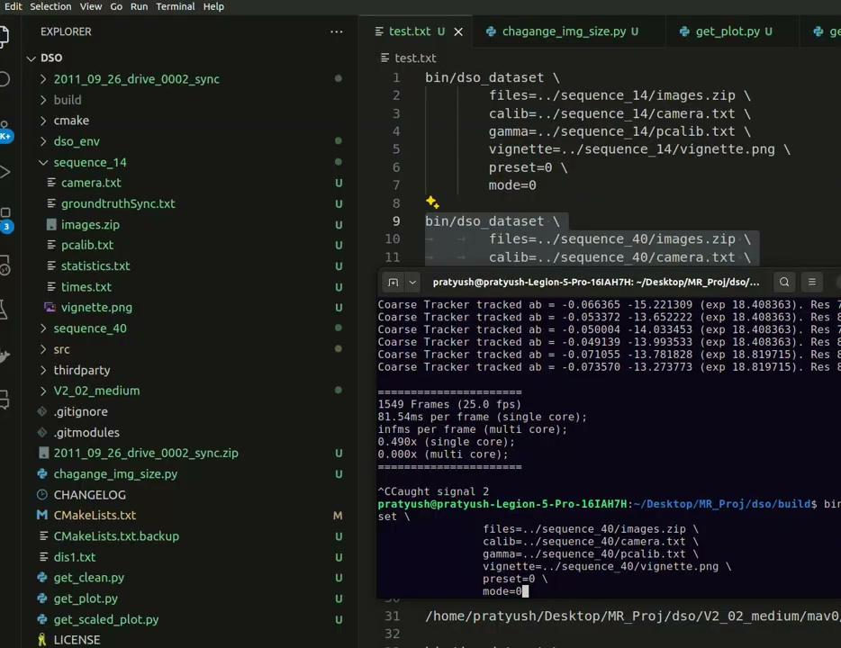
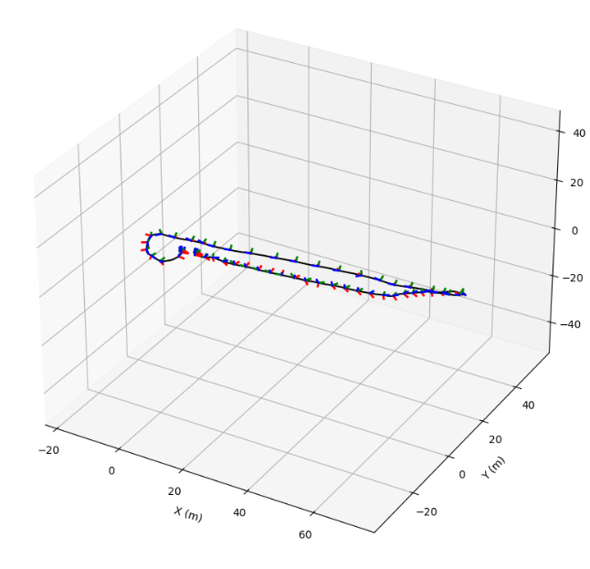
RESULTS - Sequence 40 TUM dataset
Notes:
Why use inverse depth ? To make the distribution gaussian and far points will be mapped to inf

Slide 9
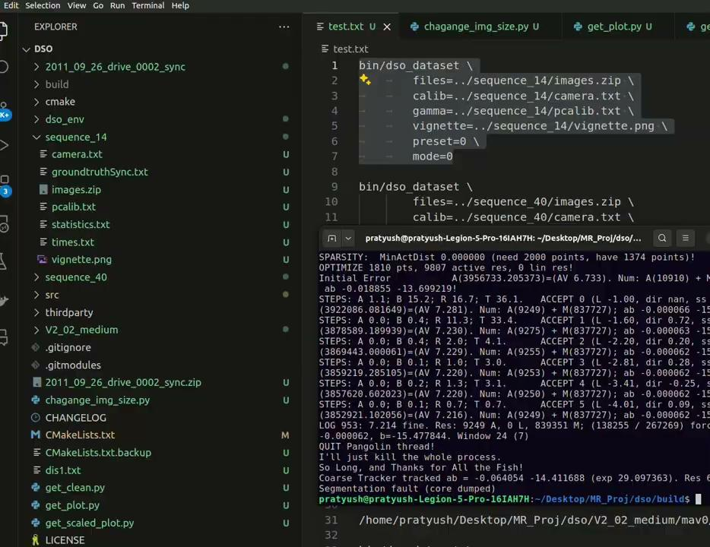
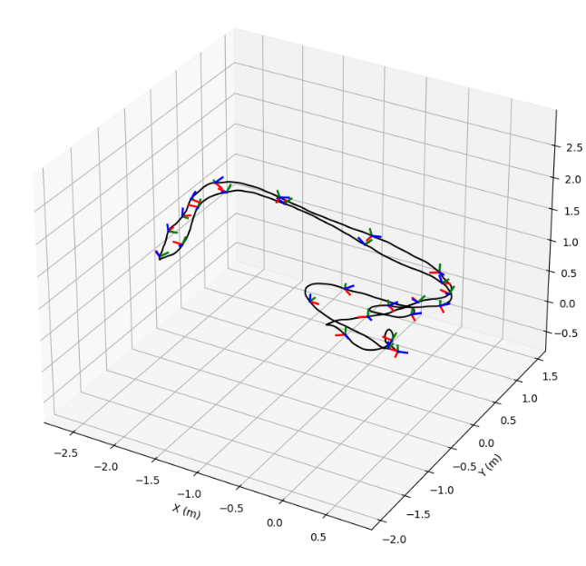
RESULTS - Sequence 14 TUM dataset
Notes:
Why use inverse depth ? To make the distribution gaussian and far points will be mapped to inf

Slide 10
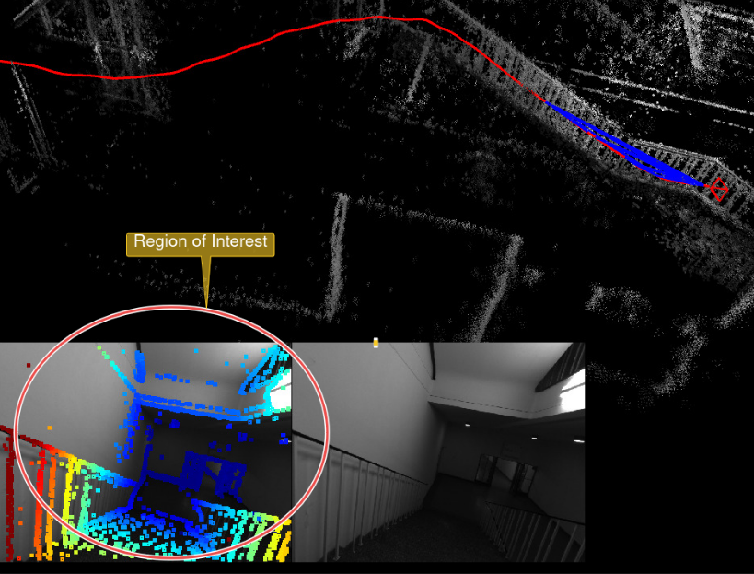
Achievements !
Observe the Region of Interest .
There are keypoints detected in areas with low texture and hence the 3D construction is successful even in areas with low texture .
Although this region lacks strong gradients, DSO is still able
to detect keypoints and process the scene successfully.
Notes:
Why use inverse depth ? To make the distribution gaussian and far points will be mapped to inf

Slide 11
FURTHER EXPLORATION
Till now :
Managed to set up and perform DSO successfully (multiple bugs and errors - workaround has been neatly documented)
Build a complete output wrapper to extract liveframes (pushLiveFrame(FrameHessian* image) ,
Depth images (pushDepthImage(MinimalImageB3* image) and much more (check the SampleOutputWrapper.h) and updated the full openCV framework as the original repo was using 2.4.10 :)
Test the functionality on various datasets (TUM , EUROC)
Further exploration :
To incorporate the pose graph bundle adjustment (DM - VIO) and benchmark the results between DSO and DSO + pose graph bundle adjustment !
Notes:
Why use inverse depth ? To make the distribution gaussian and far points will be mapped to inf

Slide 12
MOTIVATION FOR DM - VIO
Marginalization: Once marginalization is performed, it is irreversible.
Inability to Incorporate IMU Data Directly: In DSO and similar methods, marginalized states cannot be updated with new data, such as IMU measurements, making it difficult to refine the solution and leverage inertial information effectively.
Loss of Scale Information: A significant limitation of monocular visual odometry systems is that they cannot inherently estimate the absolute scale of the environment.
Notes:
Why use inverse depth ? To make the distribution gaussian and far points will be mapped to inf

Slide 13
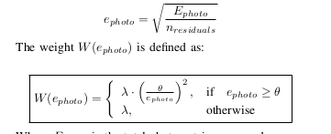
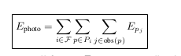
Delayed Marginalization Visual-Inertial Odometry(DM - VIO)
Es = W (ephoto ) · E photo + E imu + E prior
Photometric Error :
Refer to the report for more detailed explanation .
Notes:
Why use inverse depth ? To make the distribution gaussian and far points will be mapped to inf

Slide 14
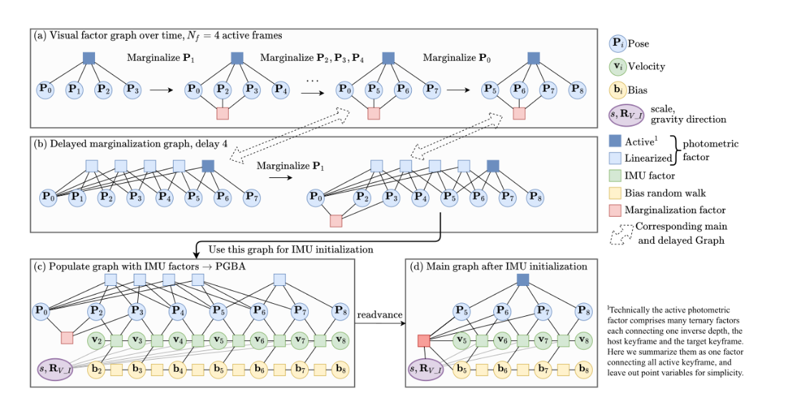
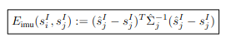
Delayed Marginalization Visual-Inertial Odometry(DM - VIO)
2. IMU error
Notes:
Why use inverse depth ? To make the distribution gaussian and far points will be mapped to inf

Slide 15
Delayed Marginalization Visual-Inertial Odometry(DM - VIO)
3. Prior error - Schur complement as in the case of DSO, we do not always marginalize the oldest pose.
ISSUE : Reverting Marginalization of a set of variables is inherently infeasible without redoing the entire marginalization process SOLUTION : Delayed Marginalization offers a mechanism to postpone this process
We used a delay of 100
Notes:
Why use inverse depth ? To make the distribution gaussian and far points will be mapped to inf

Slide 16
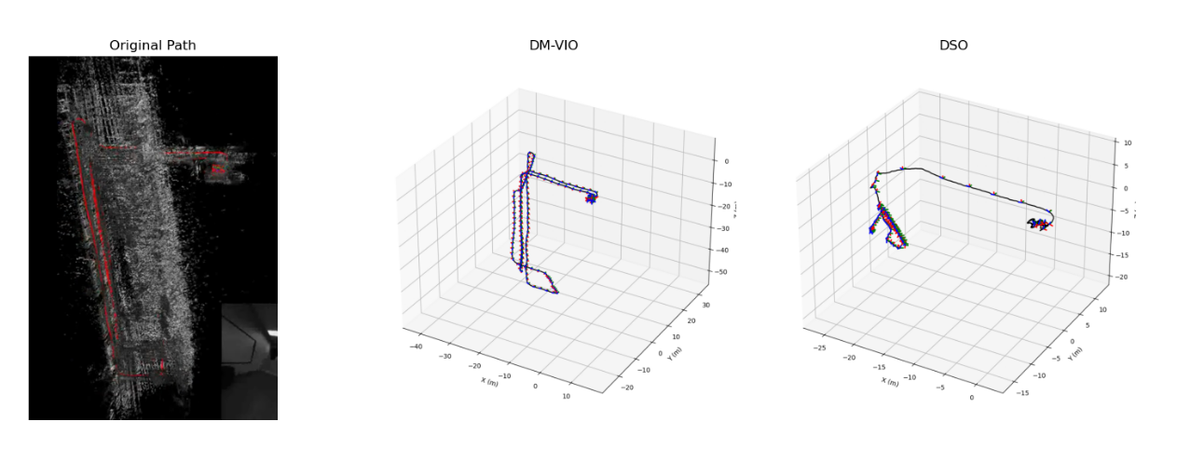
ACHIEVEMENTS !!
Loop closure
Notes:
Why use inverse depth ? To make the distribution gaussian and far points will be mapped to inf

Slide 17
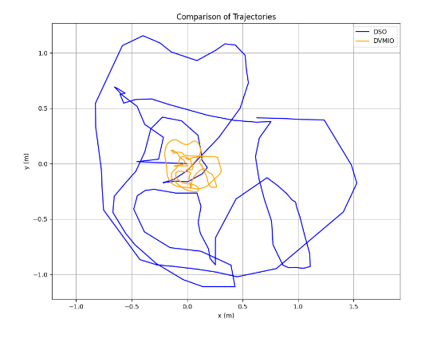
ACHIEVEMENTS !!
2. Resolving the scale ambiguity
Notes:
Why use inverse depth ? To make the distribution gaussian and far points will be mapped to inf

Slide 18
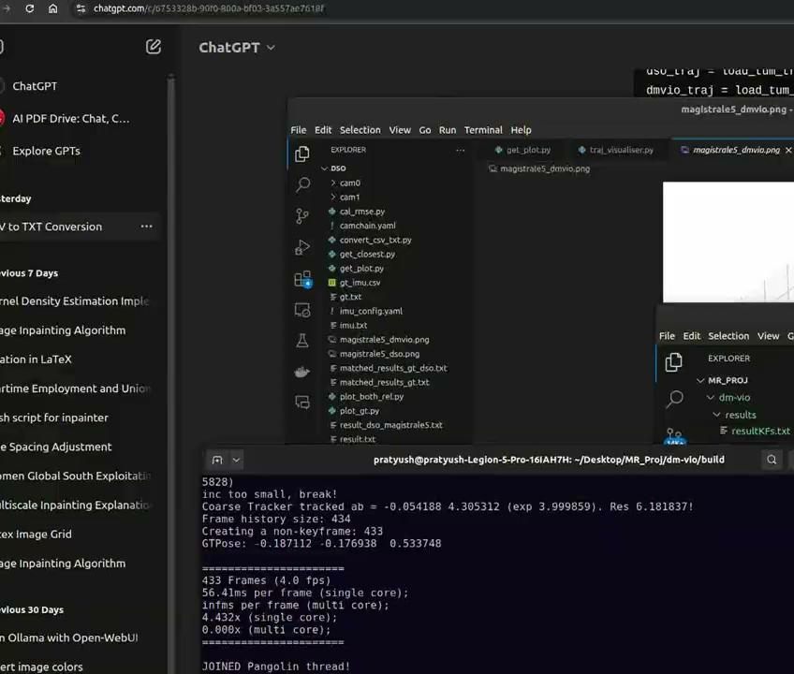
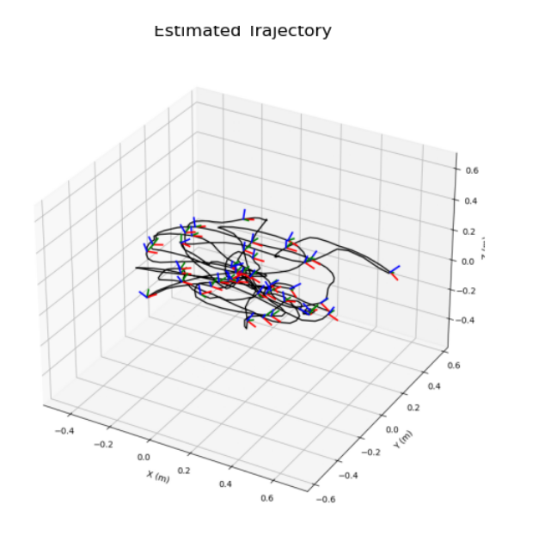
RESULTS - DM VIO - calib - cam - 1
Notes:
Why use inverse depth ? To make the distribution gaussian and far points will be mapped to inf

Slide 19
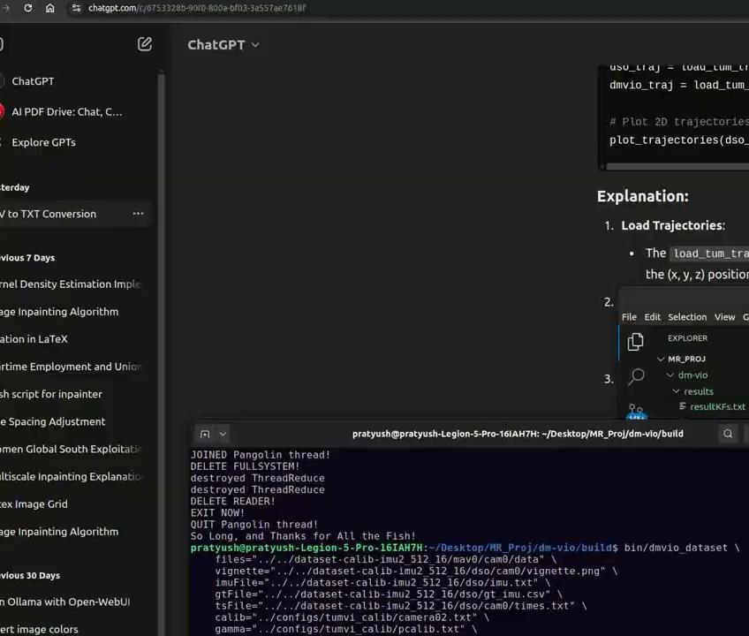
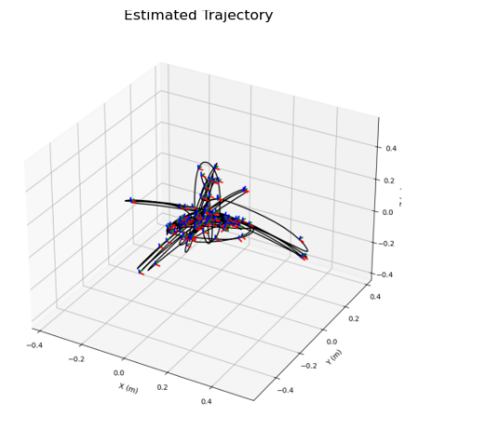
RESULTS - DM VIO - calib - imu1-512-16
Notes:
Why use inverse depth ? To make the distribution gaussian and far points will be mapped to inf

Slide 20
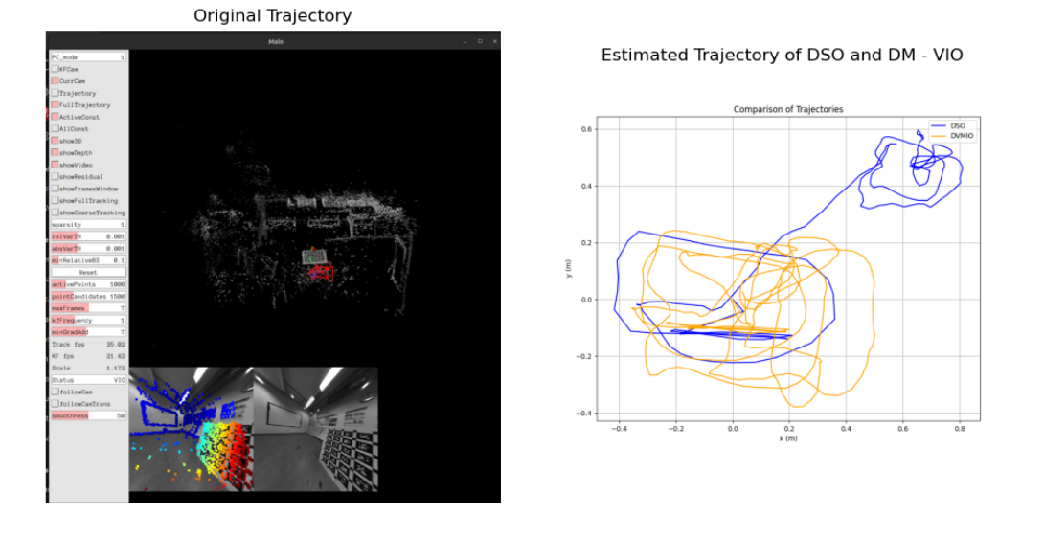
COMPARISION - DSO vs DM - VIO
CALIB - CAM - 5
Notes:
Why use inverse depth ? To make the distribution gaussian and far points will be mapped to inf

Slide 21
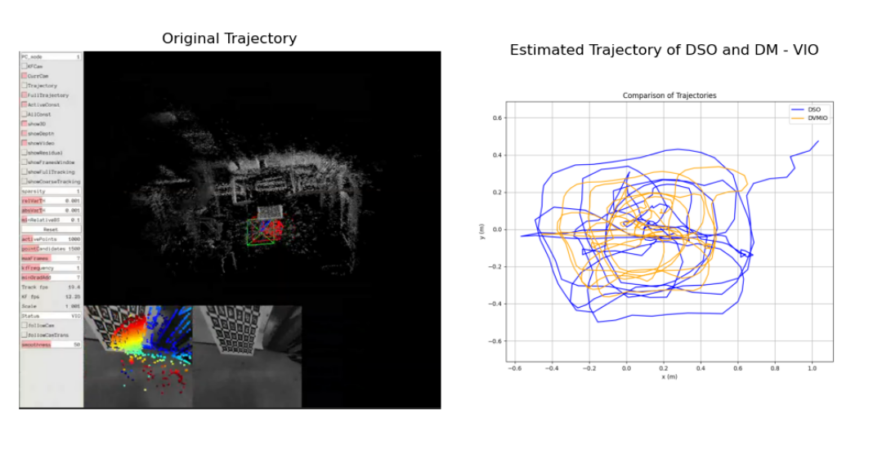
COMPARISION - DSO vs DM - VIO
CALIB - CAM - 1
Notes:
Why use inverse depth ? To make the distribution gaussian and far points will be mapped to inf

Slide 22
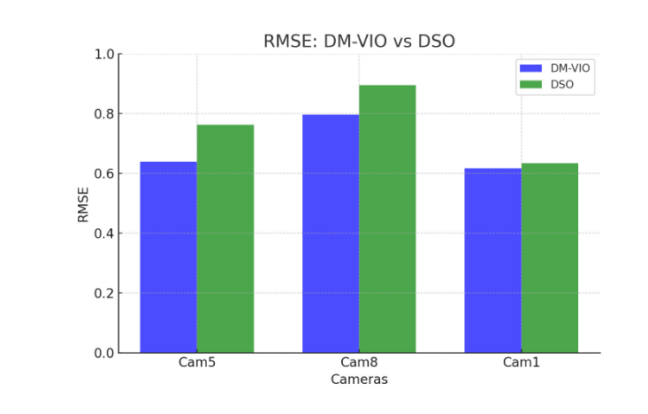
COMPARISION - DSO vs DM - VIO
Error across different scenes in a dataset
Notes:
Why use inverse depth ? To make the distribution gaussian and far points will be mapped to inf

Slide 23
Stereo Global Block Matching
Stereo Global Block Matching (SGBM) is an algorithm used to generate disparity maps for rectified stereo image pairs.
It compares blocks of pixels (small windows) in the left and right images to find the best match based on a similarity metric (e.g., Sum of Absolute Differences, SAD) and adds penalties to to ensure smooth disparity changes.
Widely used in 3D reconstruction, depth estimation, autonomous vehicles, and robotics.
SGBM balances computational efficiency and accuracy, making it suitable for real-time depth estimation tasks.

Slide 24
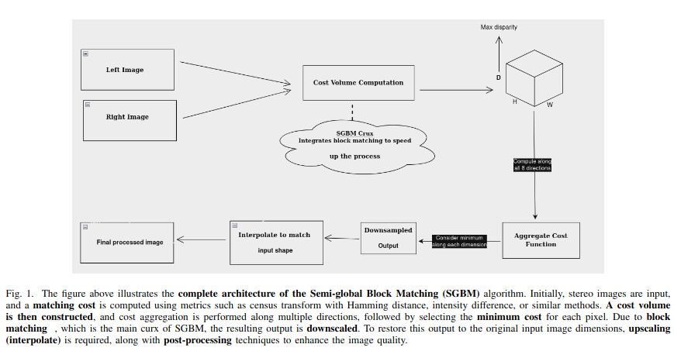
COMPLETE PIPELINE

Slide 25
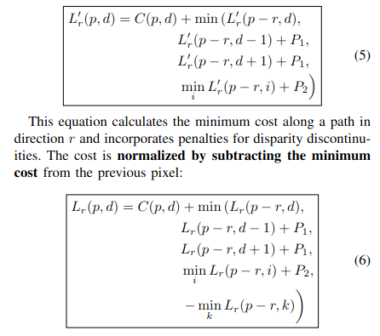
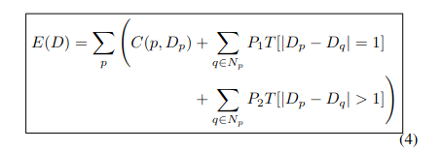
A . Formulae Used
Cost Computation:
The cost function computation can be effectively optimized by using DYNAMIC PROGRAMMING .

Slide 26
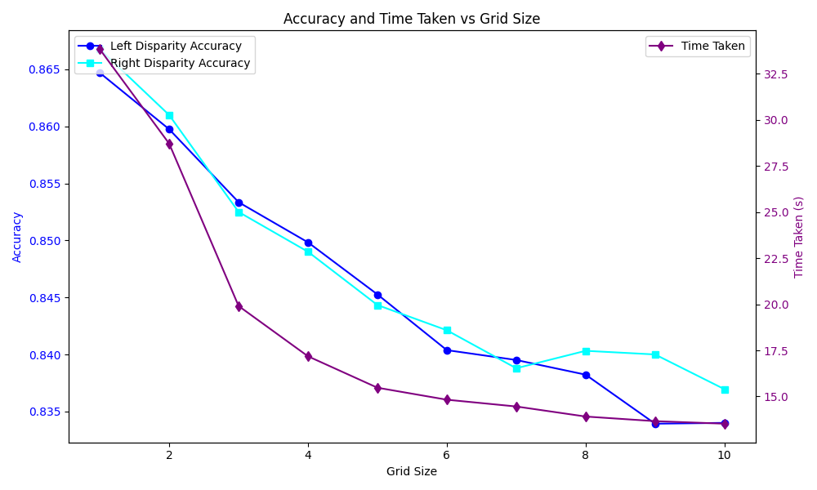
RESULTS - SGBM vs SGM
As we can see when grid_size = 1 i.e SGM we see that the time taken is the highest. As the grid size increases and the SGBM algorithm is used the time drops significantly but accuracy only drops by an insignificant amount
Notes:
Why use inverse depth ? To make the distribution gaussian and far points will be mapped to inf

Slide 27
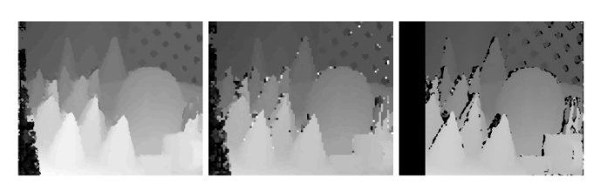
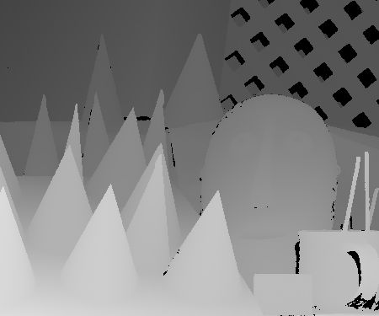
RESULTS - CONES
These images show the left disparity map created by a) SGM, b) SGBM, c) OpenCV built-in SGBM and the final image is the ground truth disparity map.
OpenCV appends a black bar onto the image instead of trying to calculate the disparity of those points and fails to handle the occlusions .
Notes:
Why use inverse depth ? To make the distribution gaussian and far points will be mapped to inf

Slide 28
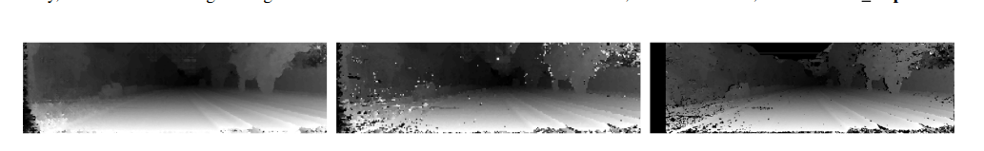
RESULTS - KITTI
These images show the left disparity map created by a) SGM, b) SGBM, c) OpenCV built-in SGBM. Post processing will be done on these images.
Notes:
Why use inverse depth ? To make the distribution gaussian and far points will be mapped to inf

Slide 29
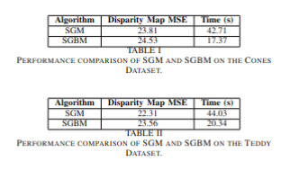
RESULTS - MSE AND TIME
Notes:
Why use inverse depth ? To make the distribution gaussian and far points will be mapped to inf

Slide 30
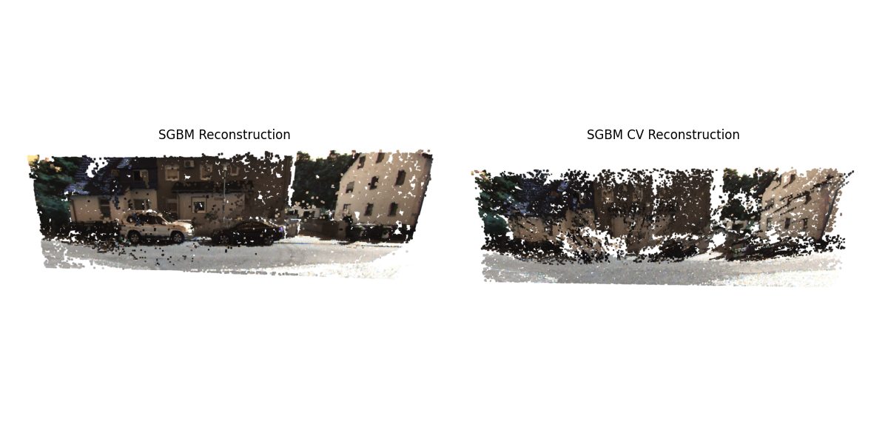
3D Reconstructions
Notes:
Why use inverse depth ? To make the distribution gaussian and far points will be mapped to inf

Slide 31
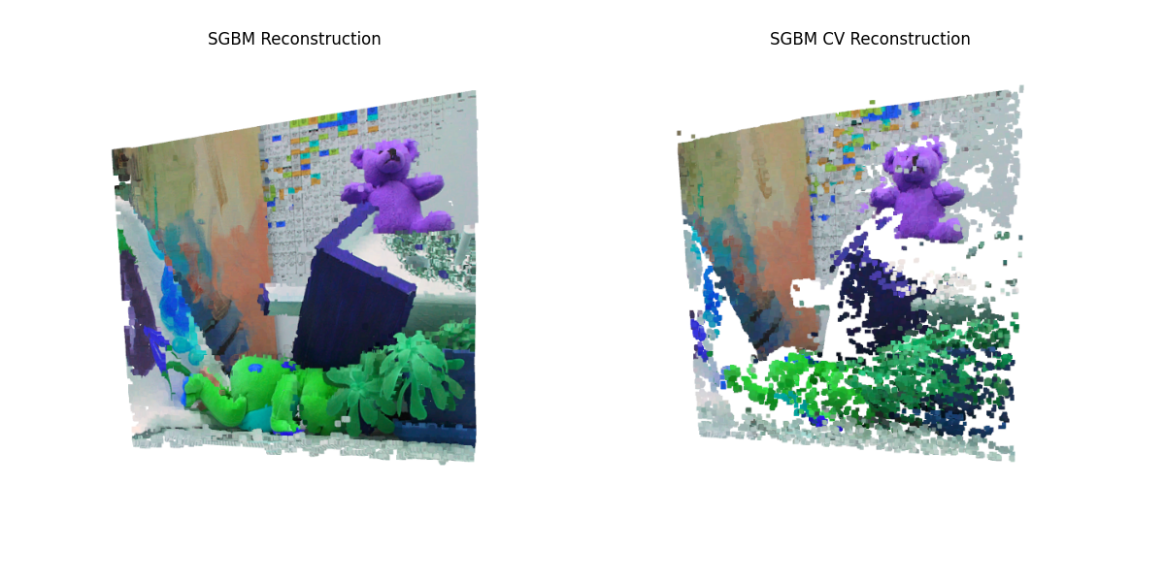

Slide 32
